Slide 1
Introduction to Assembly Language
Delivered by: Belal Hashmi

Slide 2
BASIC COMPUTER ARCHITECTURE
A computer system comprises of a processor, memory, and I/O devices.
I/O is used for interfacing with the external world, while memory is the processor’s internal world
Processor is the core in this picture and is responsible for performing operations
Notes:
The processor fetches the instruction value from this memory location. Once the instruction has been fetched, it needs to be decoded and executed

Slide 3
Instruction Cycle
The CPU fetches instructions from memory, reads and writes data from and to memory, and transfers data from and to input/output devices.
A typical and simple execution cycle can be summarized as follows:
1. The next instruction to be executed, whose address is obtained from the PC, is fetched from the memory and stored in the IR.
2. The instruction is decoded.
3. Operands are fetched from the memory and stored in CPU registers, if needed.
4. The instruction is executed.
5. Results are transferred from CPU registers to the memory, if needed.

Slide 4
Scenario
Memory is a dumb device
The scenario that the processor executes operations, and the memory contains data elements requires a mechanism for the processor to read that data from the memory

Slide 5
Key points
There must be a mechanism to inform memory that we want to do the read operation
There must be a mechanism to inform memory that we want to read precisely which element
There must be a mechanism to transfer that data element from memory to processor

Slide 6
Buses
The group of bits that the processor uses to inform the memory about which element to read or write is collectively known as the address bus.
data bus is used to move the data from the memory to the processor in a read operation and from the processor to the memory in a write operation.
Line of the bus is used to inform the memory about whether to do the read operation or the write operation. These lines are collectively known as the control bus

Slide 7
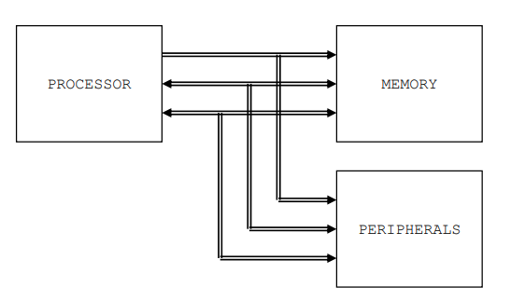
Buses

Slide 8
Buses
The two dimensions, cell width and number of cells
Word size of the memory(parallel bits)
Same size of data bus and memory cell width.
Control bus carries the intent of the processor
Memory changes its behavior( direction of flow of data) in response to this signal from the processor.
Precise synchronization between the processor and the memory is the responsibility of the control bus.

Slide 9
Buses
why is the control bus bidirectional?
Information cannot be transferred via the address or the data bus.
Indicate the incapability of the peripheral to do something for the moment.

Slide 10
Registers
operations need operands. One address bus and one data bus.
Temporary storage places inside the processor called registers(precious resource)
Sometimes we hold both operands in registers for the sake of efficiency
Nomenclature(naming is useful since the registers are few in number)

Slide 11
Registers
Accumulator :Central register in every processor called the accumulator. Traditionally all mathematical and logical operations are performed on the accumulator. The word size of a processor is defined by the width of its accumulator.
Pointer, Index, or Base Register: Does not hold data but holds the address of data.
Flags Register or Program Status Word: meaningless as a unit
Program Counter or Instruction Pointer: The program counter holds the address of the next instruction to be executed.

Slide 12
Registers
Opcode : one number tells it that it has to add, where its operands are, and where to store the result
mnemonic : associate a symbol to every number

Slide 13
INSTRUCTION GROUPs
Data Movement Instructions
mov ax, bx lad 1234
Arithmetic and Logic Instructions
and ax, 1234
add bx, 0534
add bx, [1200]
Program Control Instructions
cmp ax, 0
jne 1234
Special Instructions
cli sti

Slide 14
INTEL IAPX88 ARCHITECTURE
iAPX88 stands for “Intel Advanced Processor Extensions 88”
8088 is a 16bit processor
downward compatible
The architecture of a processor means the organization and functionalities of the registers
History(64K on the 8085, the 8088 allowed a whole mega byte)

Slide 15
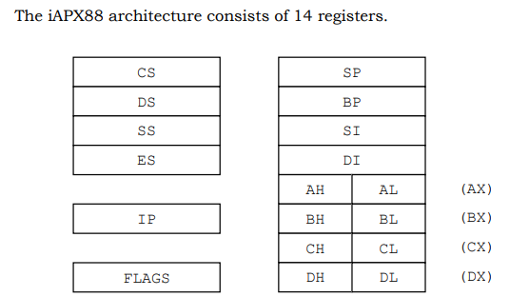
REGISTER ARCHITECTURE

Slide 16
REGISTER ARCHITECTURE
General Registers (AX, BX, CX, and DX) Accumulator, base, counter, destination
Index Registers (SI and DI): allows methametical and logical operations. implied functionality as the source or the destination in a special class of instructions called the string instructions. Not restricted to just string instructions. Cannot be used as 8 bit.
Instruction Pointer (IP): address of the next instruction to be executed. address of the next instruction to be executed
Stack Pointer (SP): memory pointer
Base Pointer (BP): memory pointer
Flags Registers
Segment Registers (CS, DS, SS, and ES)

Slide 17
Flag Registers

Slide 18
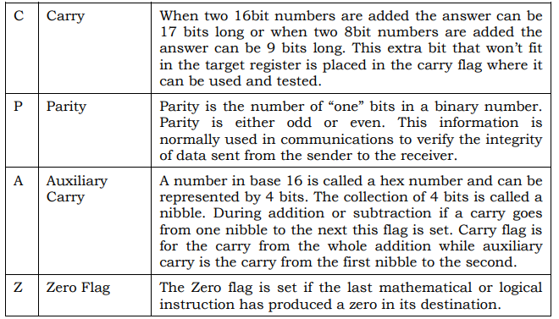
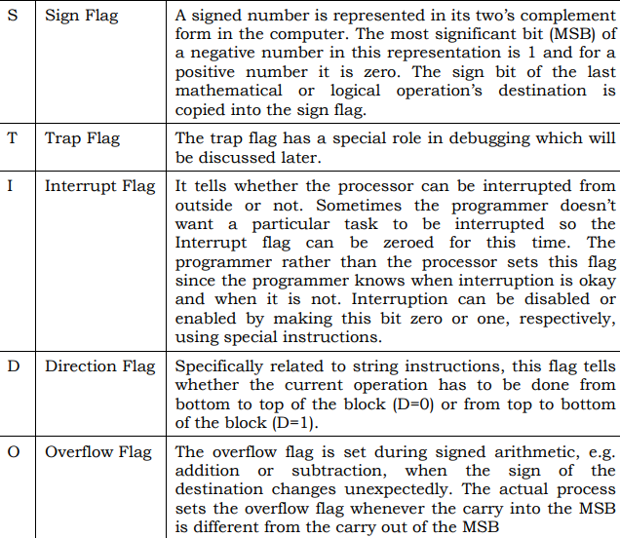
Flags

Slide 19
Assembler, Linker, and Debugger
“Netwide Assembler” or NASM.
“A fullscreen debugger” or AFD

Slide 20
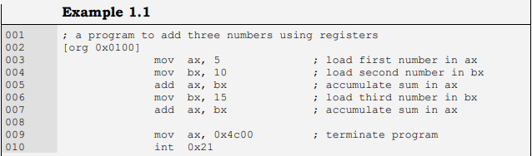
First Program

Slide 21
First Program Assembling
To assemble we will give the following command to the processor assuming that our input file is named
EX01.ASM. nasm ex01.asm –o ex01.com –l ex01.lst
Produce two files EX01.COM that is our executable file and EX01.LST

Slide 22
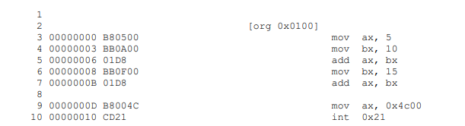
List file

Slide 23
First Program
little-endian order and is used by Intel
least significant, more significant, more significant, and most significant
size of the complete COM file?
18 bytes

Slide 24

Intel way of writing
The last three variations are for instructions that have one or both of their operands implied, or they work on a single or no operand. An implied operand means that it is always in a particular register say the accumulator, and it need not be mentioned in the instruction

